Slide 1
Reference Dashboards

Slide 2
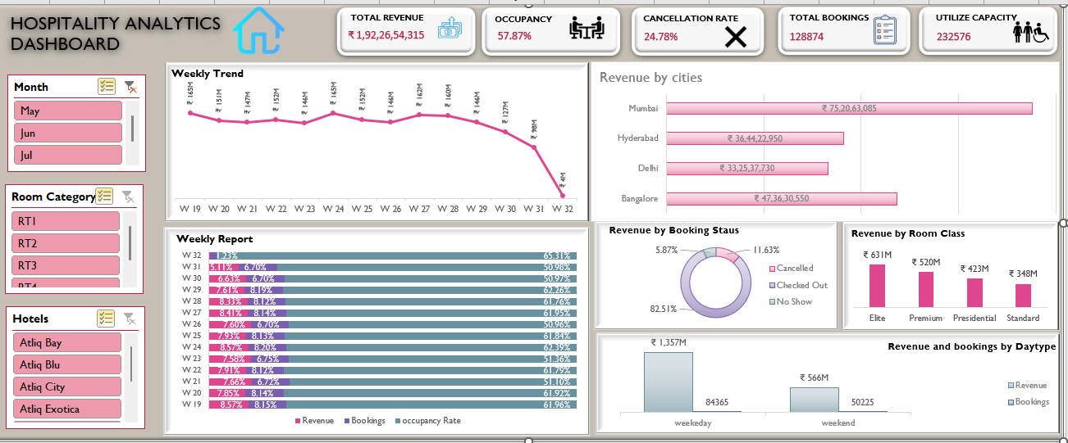
Excel Dashboard

Slide 3
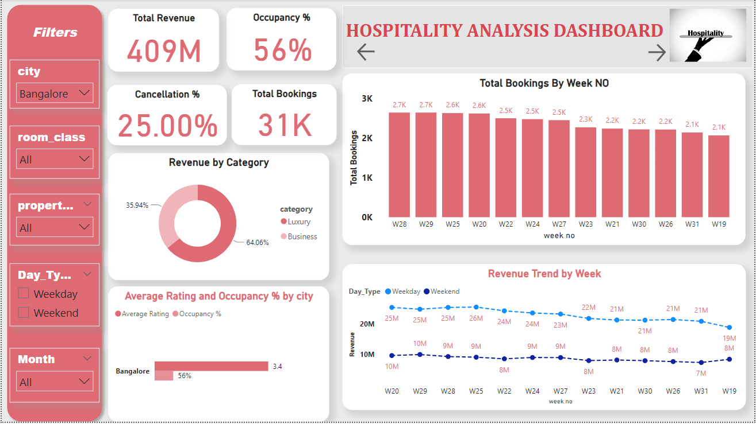
Power BI Dashboard

Slide 4
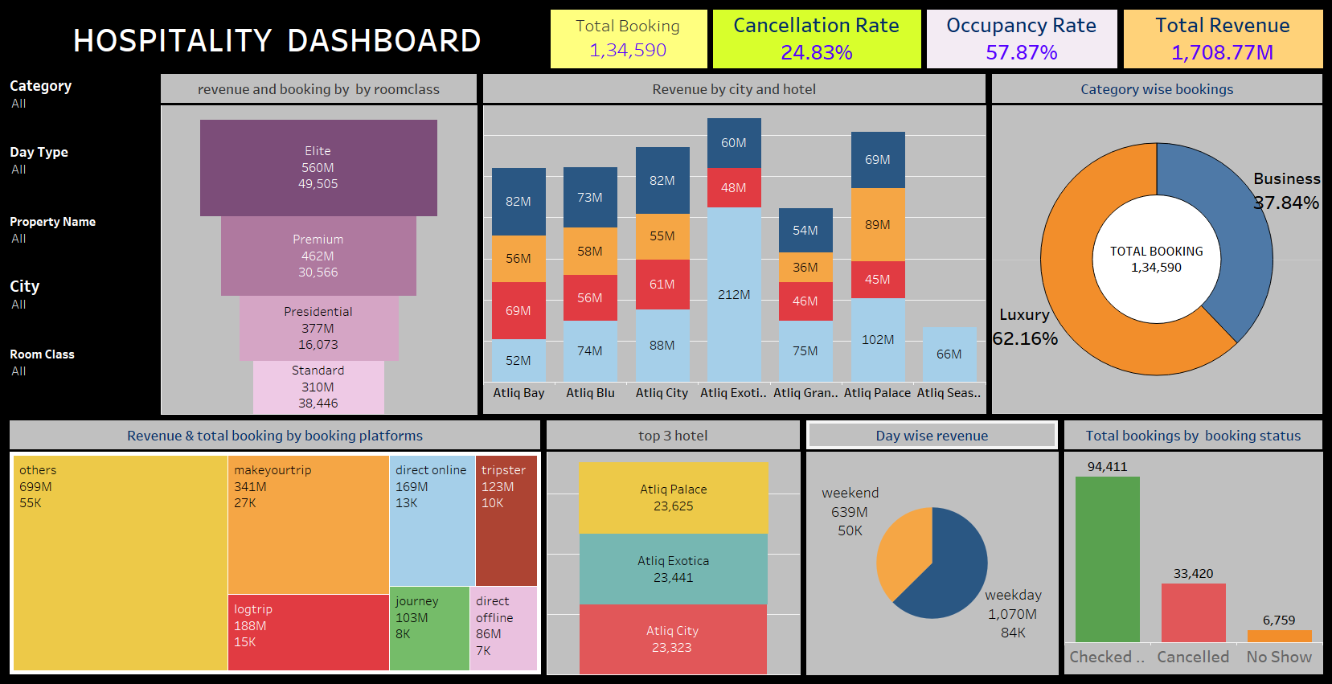
Tableau Dashboard

Slide 5











MySQL Queries

